Slide 1
ITCS 3134
YIN HANG KWOK
800831787
E08 - Filter 01 (Gaussian Filter)

Slide 2
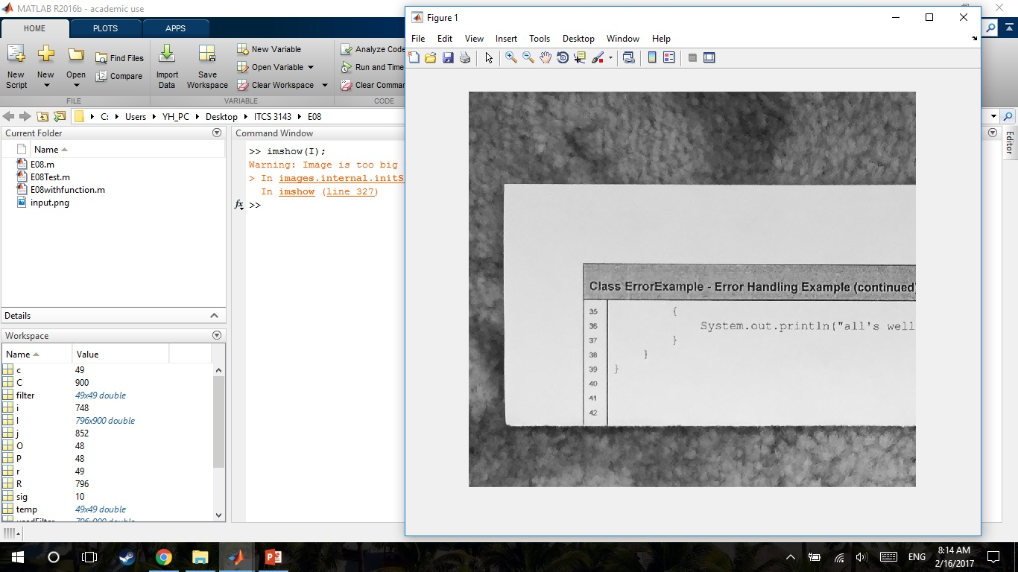
Input image
I = imread('input.png');
imshow(I);

Slide 3
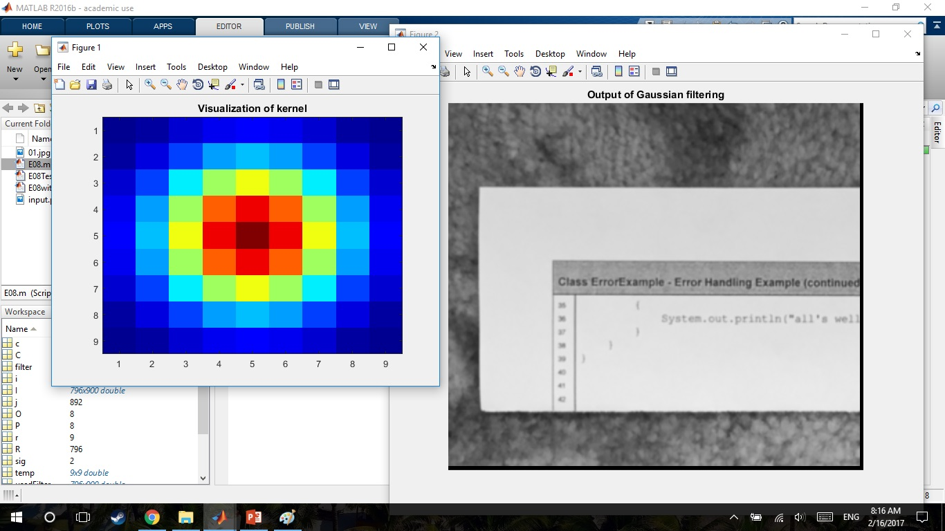
values of sigma = 2
sig = 2.0; %SD
wh = floor(2.5 * sig - 0.5);
w = zeros((wh*2+1),(wh*2+1));

Slide 4
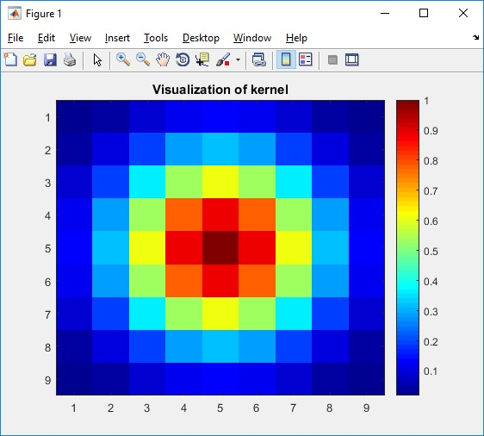
Visualization of kernel (use jet colormap % colormap jet)

Slide 5
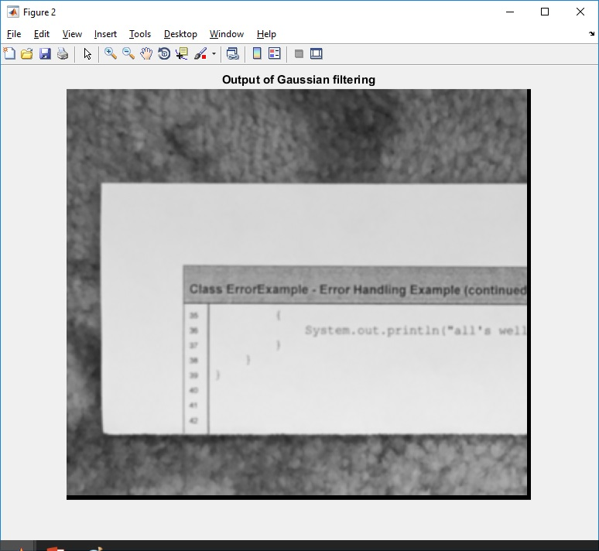
Output of Gaussian filtering

Slide 6
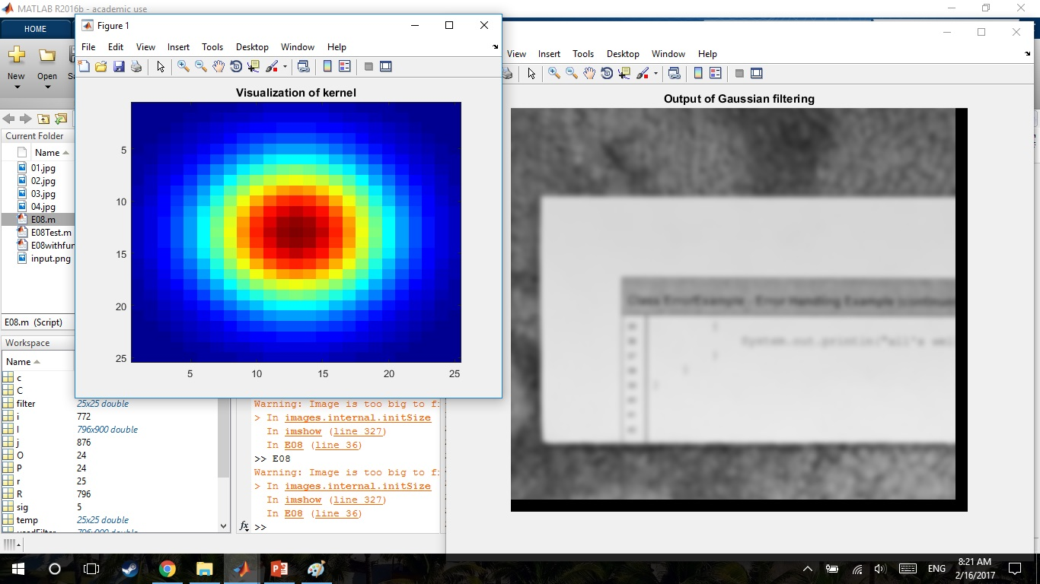
values of sigma = 5
sig = 5.0; %SD
wh = floor(2.5 * sig - 0.5);
w = zeros((wh*2+1),(wh*2+1));

Slide 7
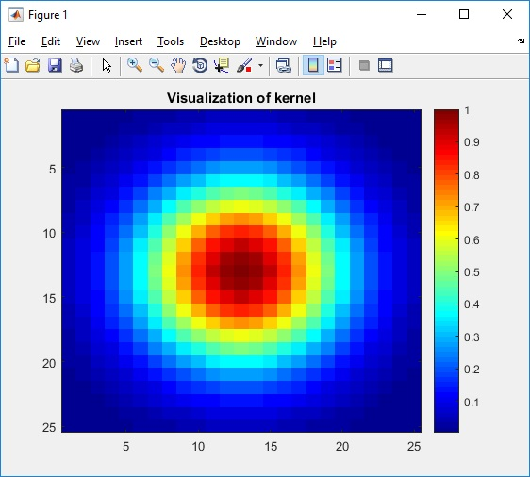
Visualization of kernel (use jet colormap % colormap jet)

Slide 8
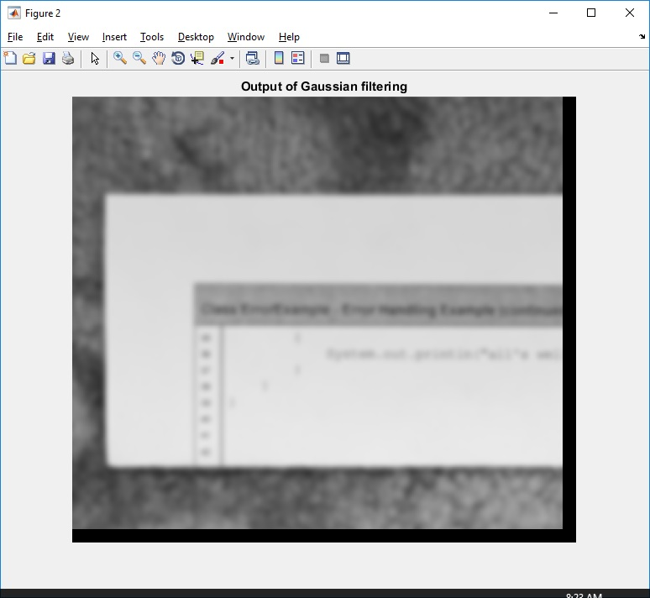
Output of Gaussian filtering

Slide 9
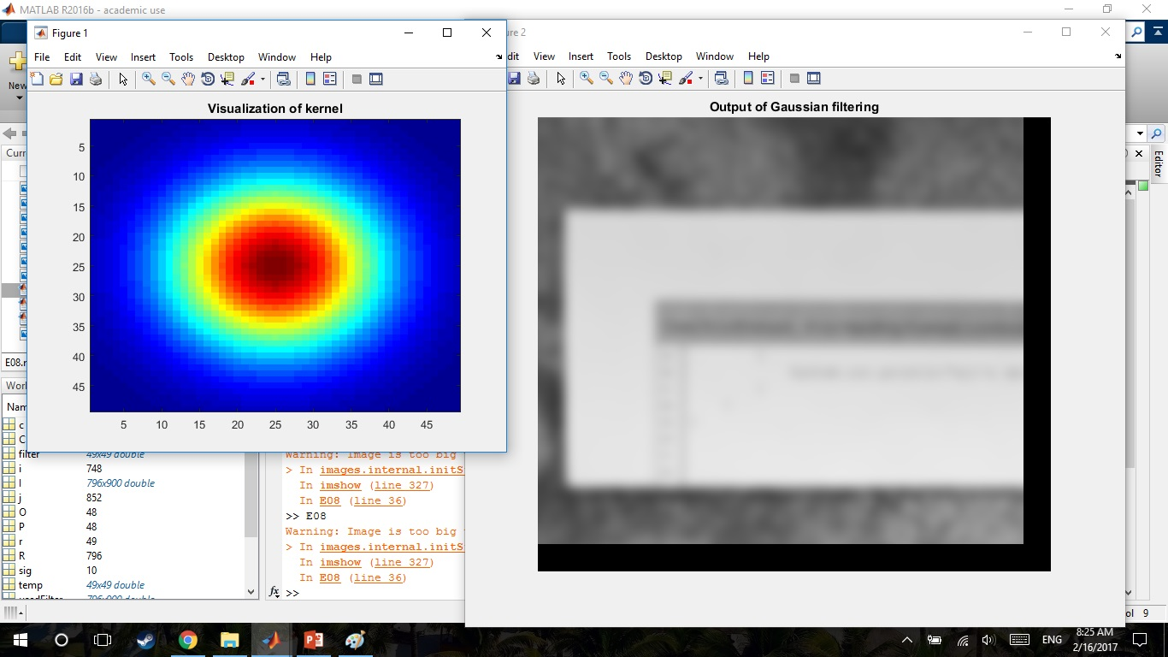
values of sigma = 10
sig = 10.0; %SD
wh = floor(2.5 * sig - 0.5);
w = zeros((wh*2+1),(wh*2+1));

Slide 10
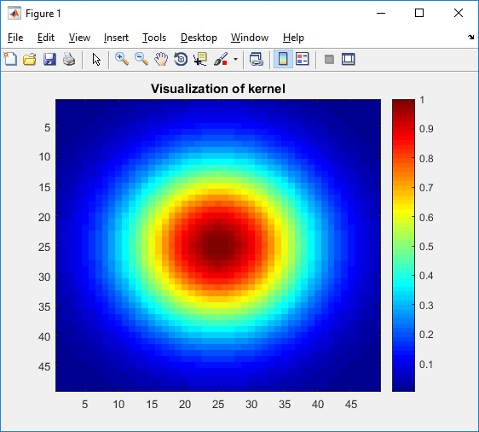
Visualization of kernel (use jet colormap % colormap jet)

Slide 11
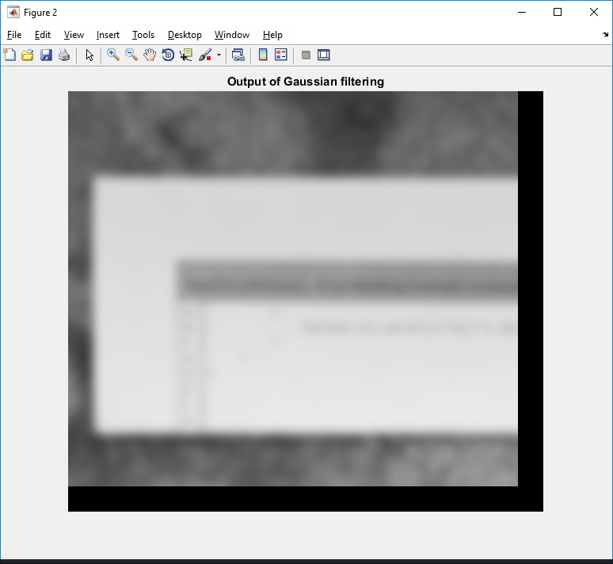
Output of Gaussian filtering

